Slide 1
EOC VIVA_4

Slide 2
SUBMITTED BY TEAM-11 BATCH-A
TEAM MEMBERS ARE
VIKHYAT BANSAL - [CB.EN.U4AIE21076]
VIGNESH - [CB.EN.U4AIE21075]
MARREDDY MOHIT SASANK REDDY - [CB.EN.U4AIE21031]
YARAM SRI SATHWIK REDDY - [CB.EN.U4AIE21077]

Slide 3
01
Explain the concept of pointers in Hack Assembly language. Write a hack assembly language program to create an array of size 25 with values -1

Slide 4
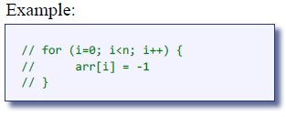
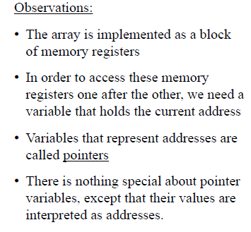
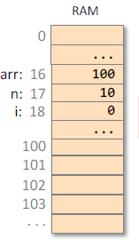
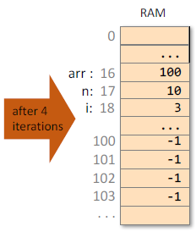
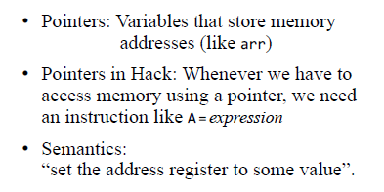
Pointers
Array is taken as segment in the register that has a starting address.

Slide 5
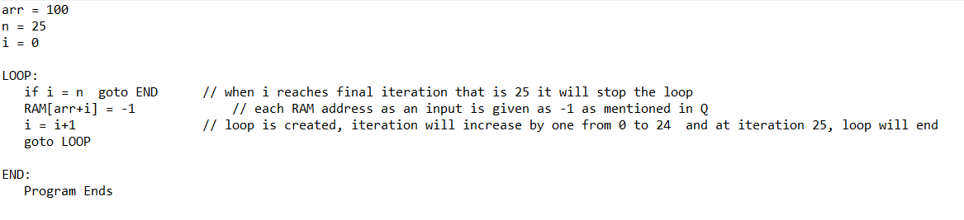
PSEUDO CODE:

Slide 6
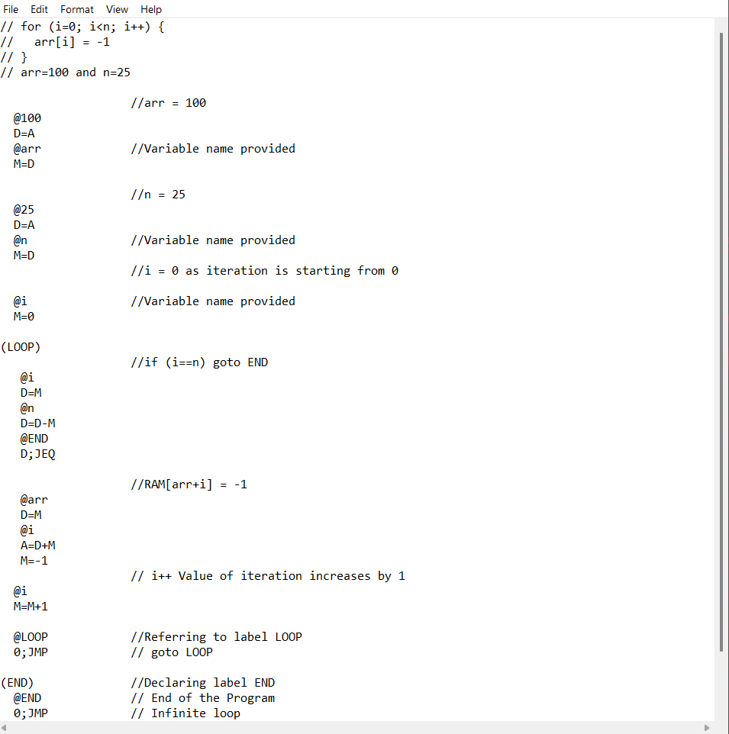
ASSEMBLY CODE:

Slide 7
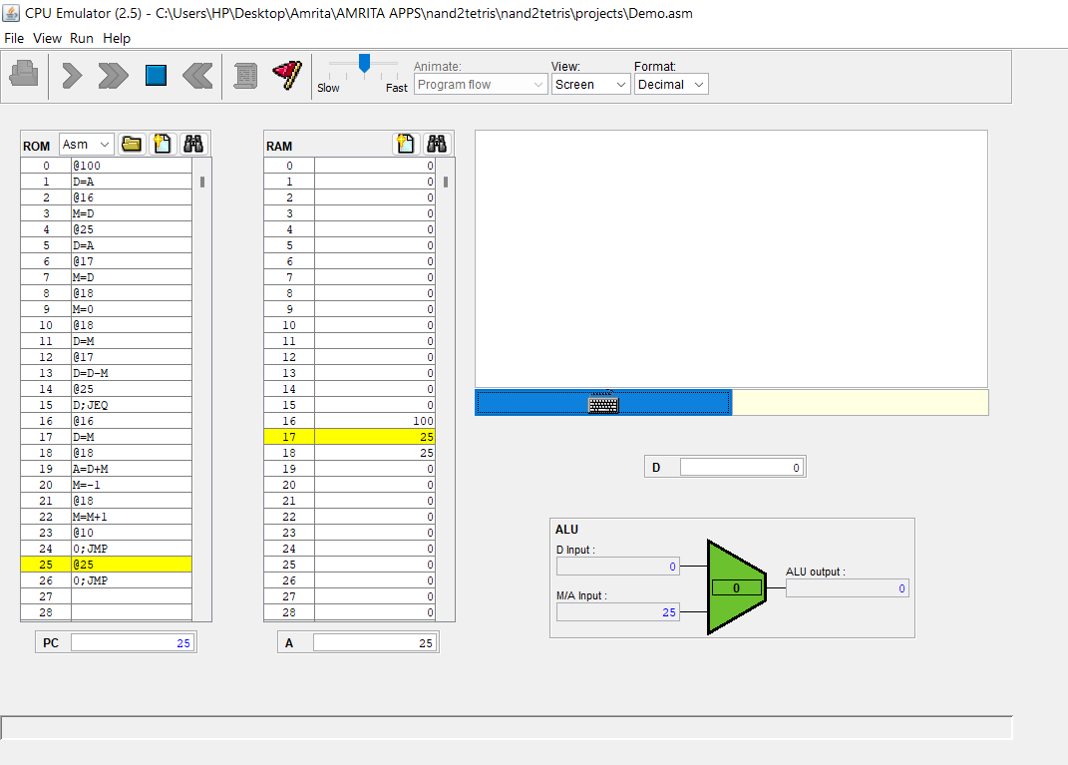
Output:

Slide 8
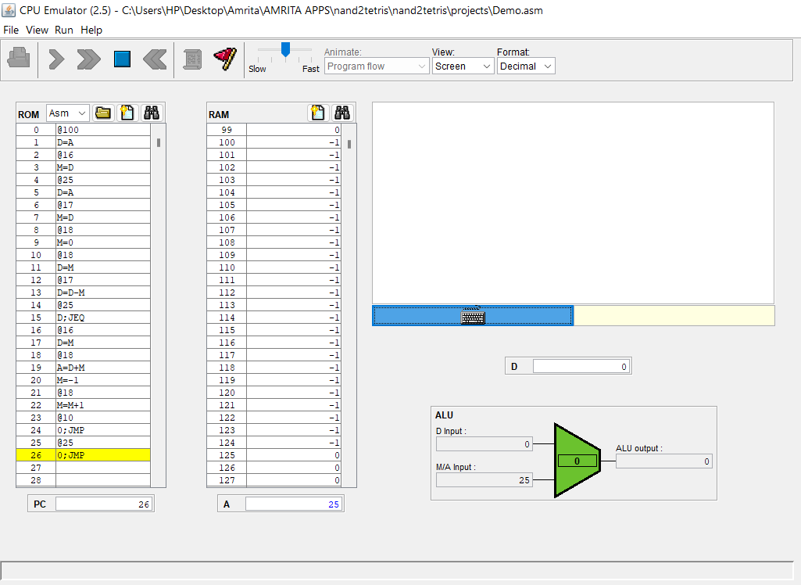
Output:

Slide 9
02
Explain about the screen-memory map in Hack computer. Write a hack assembly language program to draw a rectangle at the lower right corner, 32 pixel wide and 100 pixel long.

Slide 10
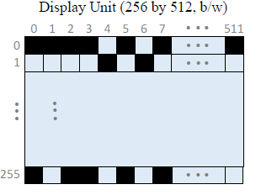
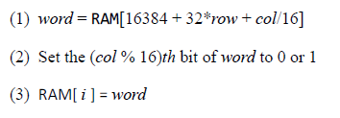
Screen Memory Map
To set pixel (row, Col) on/off:
The designated memory area, dedicated to manage a display unit is called Screen Memory map.
The physical display is continuously refreshed from the memory map, many times per second.
Output is effected by writing code that manipulates the screen memory map.
We need 8K bits for screen memory map, total bits used are :
= 256*(32*16) = 131072
The Screen memory map is implemented using a 8K chip called Screen.

Slide 11
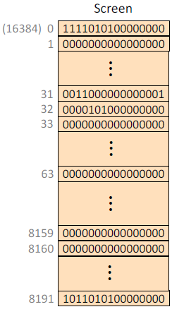
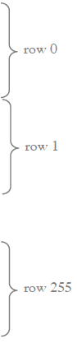
Screen Memory Map
CAREFULLY OBSERVING THIS SLIDE WE CAN SEE THAT:
AT RAM ADDRESS 16384 ,SCREEN MEMORY MAP IS LOCATED AND IT ENDS AT (16384+8191=24575) 32 ROWS corresponds to a single row worth of pixels of screen. From bit interpretation on screen memory map it can be seen that row 0(of screen memory map) starts with 1 which gives black pixels on screen for ROW 1 and COLUMN 0 and moving on we can see that row 31(of screen memory map) ends with 1 which gives black pixel on screen for ROW 1 and COLUMN 511 . (Refer to image given in above slide).
BIT REPRESENTATION: 0 = White(+ve) 1 = Black (-ve)

Slide 12
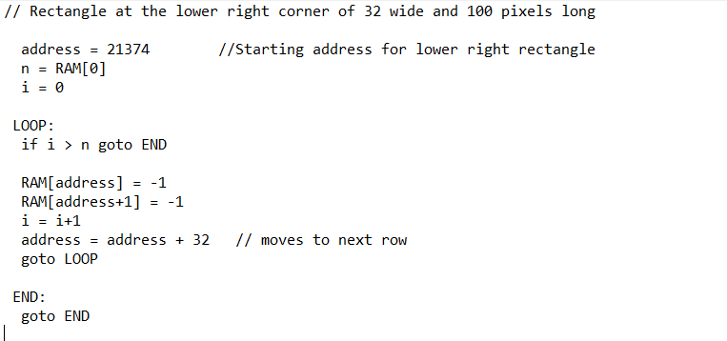
PSEUDO CODE:

Slide 13
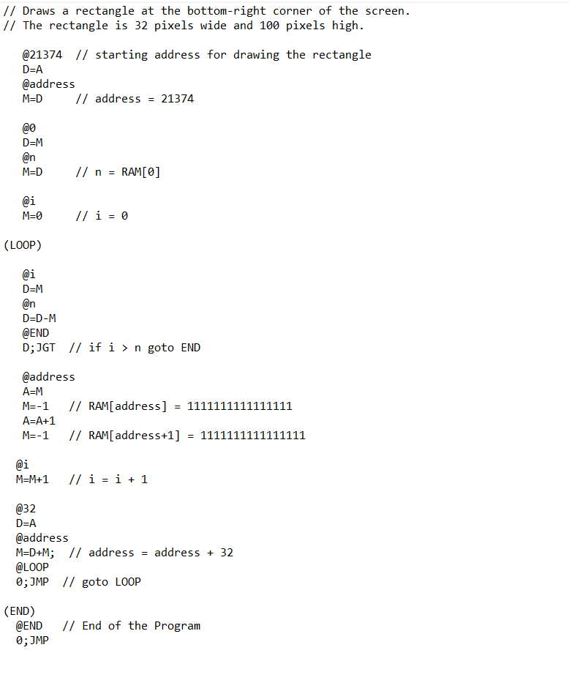
ASSEMBLY CODE:

Slide 14
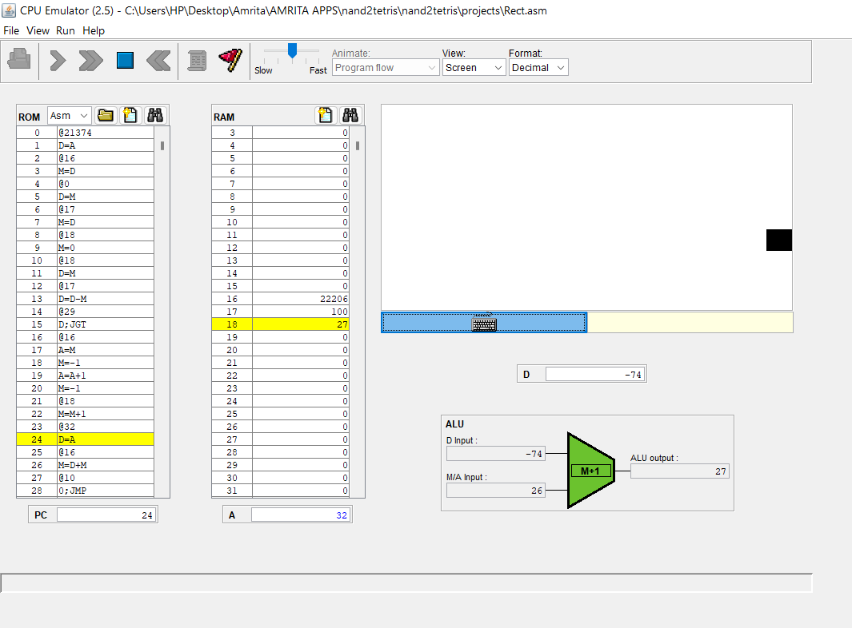
Output (In-Progress)

Slide 15
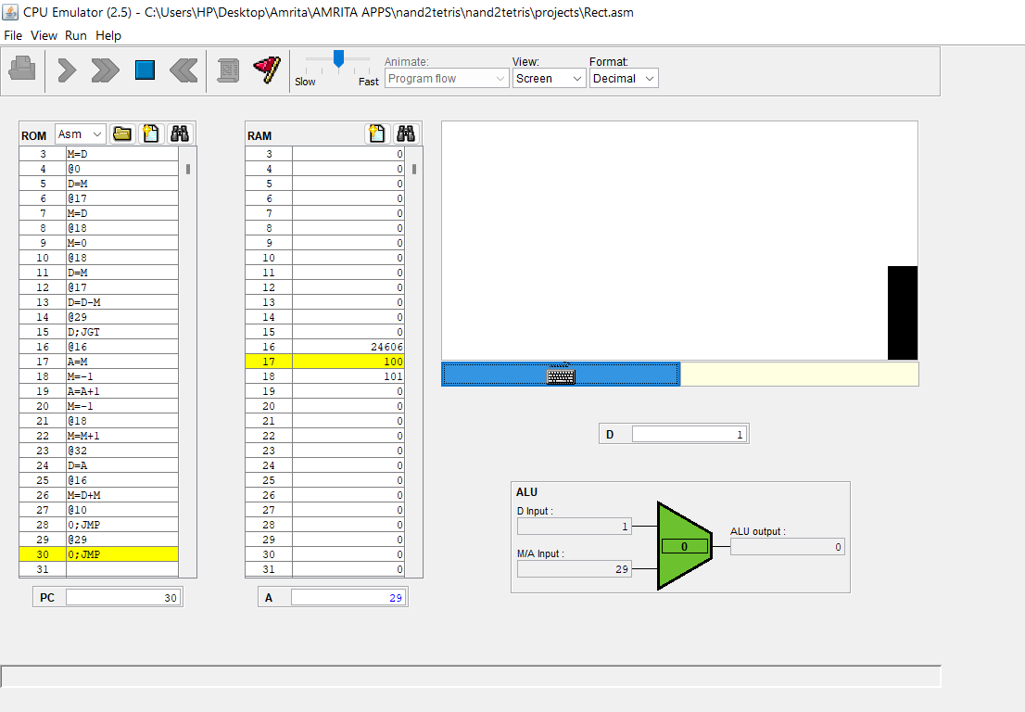
Output (Completed)

Slide 16
03
Write a hack assembly language program to blacken the entire pixels on the screen on a ‘keypress’ by the user.

Slide 17
Hack assembly language program to blacken the entire pixels on the screen on a ‘keypress’ by the user.
For this implementation of blacken the entire pixels on screen we have to press and hold any key on the keyboard. In this I'm used “space” to show this. We can also use any other key in the keyboard.

Slide 18
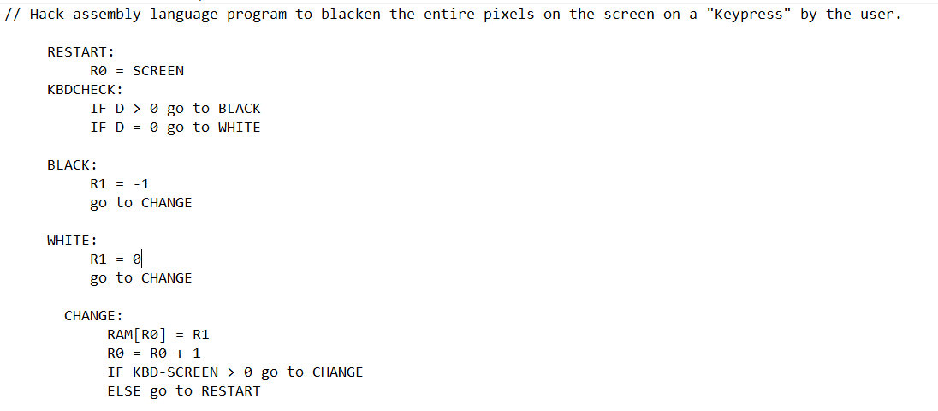
Pseudo code:

Slide 19
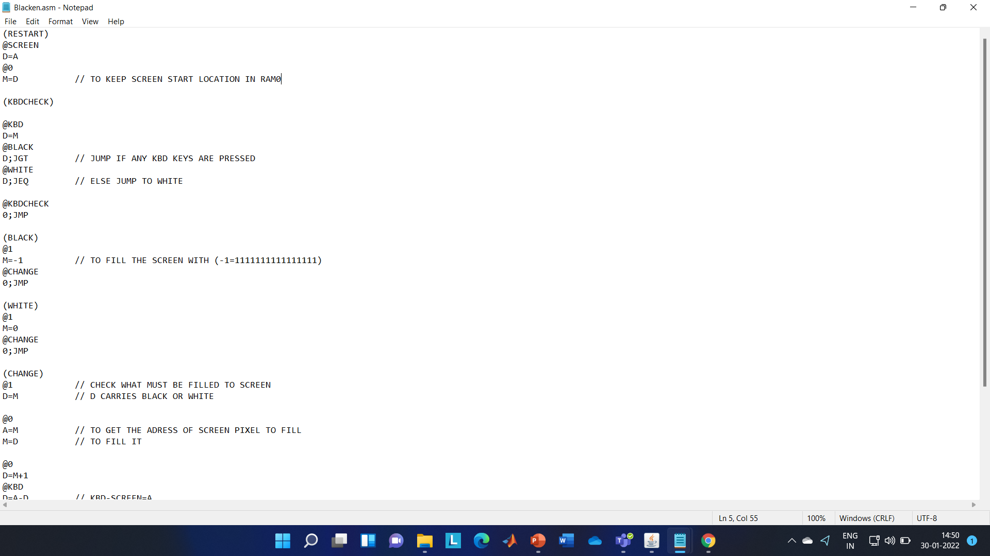
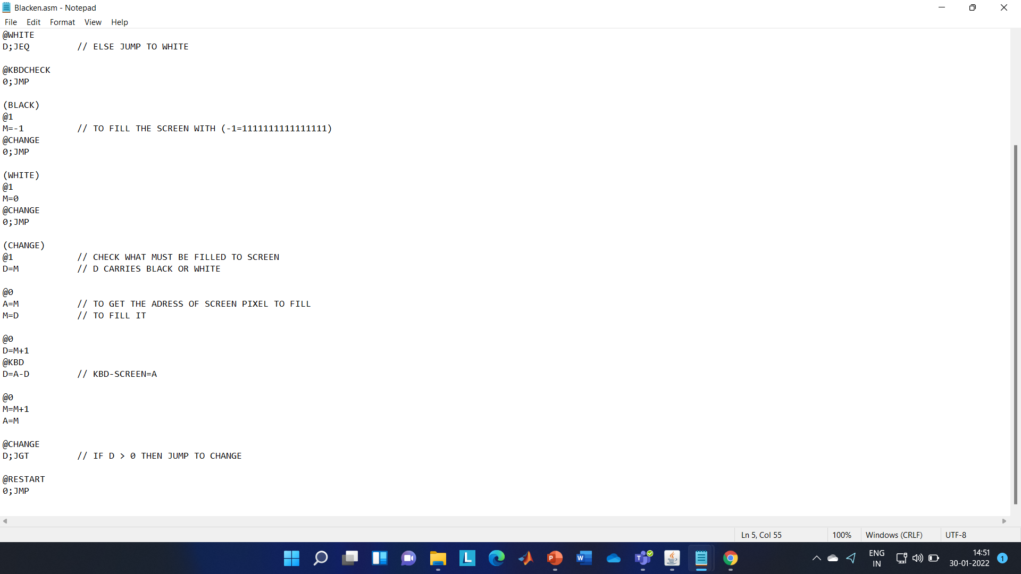
Assembly code:

Slide 20
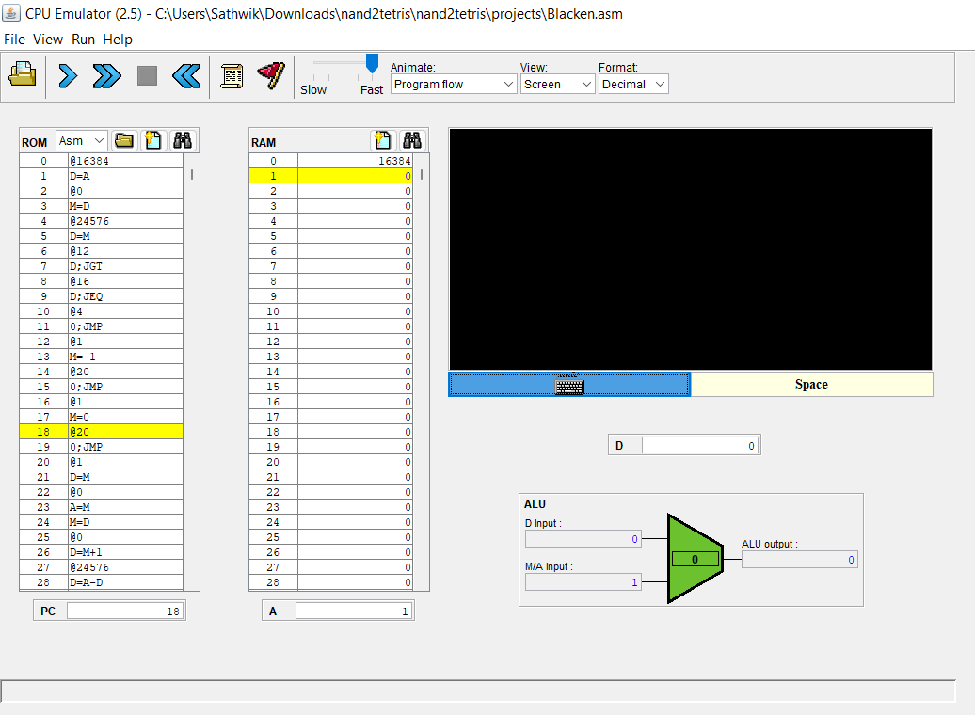
Output:

Slide 21
Thank you!

